Slide 1
03 - Lexical Representations
Nick Riches
How are words stored?
Storage metaphors
Data from production errors Blends
03 - Lexical Representations
Meaning-related rels.
Hyponymy Synonymy Antonymy Homonymy Polysemy
Homonyms versus Polysemes
Nick Riches
Newcastle University
Lexical gaps
What is a lexical gap?
October 17, 2018
Form-related rels.
Homophony Homography
Exploring sem. networks
Paradigms for exploring semantic networks
Speech errors
Types of speech errors
5-minute Exercise
1 / 35
Bibliography

Slide 2
03 - Lexical Representations
Nick Riches
How are words stored?
How are words stored?
Storage metaphors
Data from production errors Blends
Meaning-related relationships
Meaning-related rels.
Hyponymy Synonymy Antonymy Homonymy Polysemy
Homonyms versus Polysemes
Lexical gaps
Form-related relationships
Lexical gaps
What is a lexical gap?
Exploring semantic networks
Form-related rels.
Homophony Homography
Exploring word production using speech errors
Exploring sem. networks
Paradigms for exploring semantic networks
Speech errors
Types of speech errors
5-minute Exercise
5-minute Exercise
1 / 35
Bibliography

Slide 3
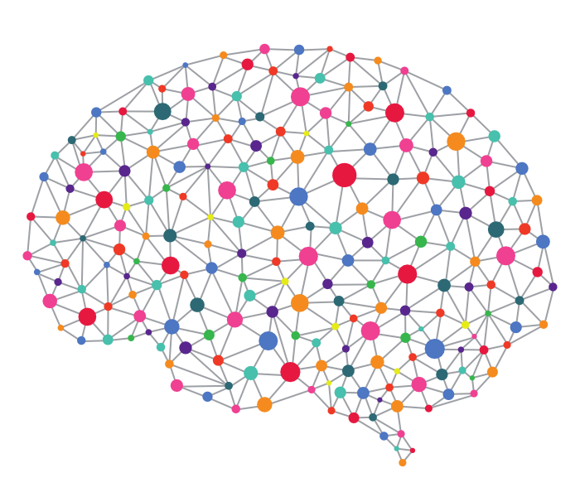
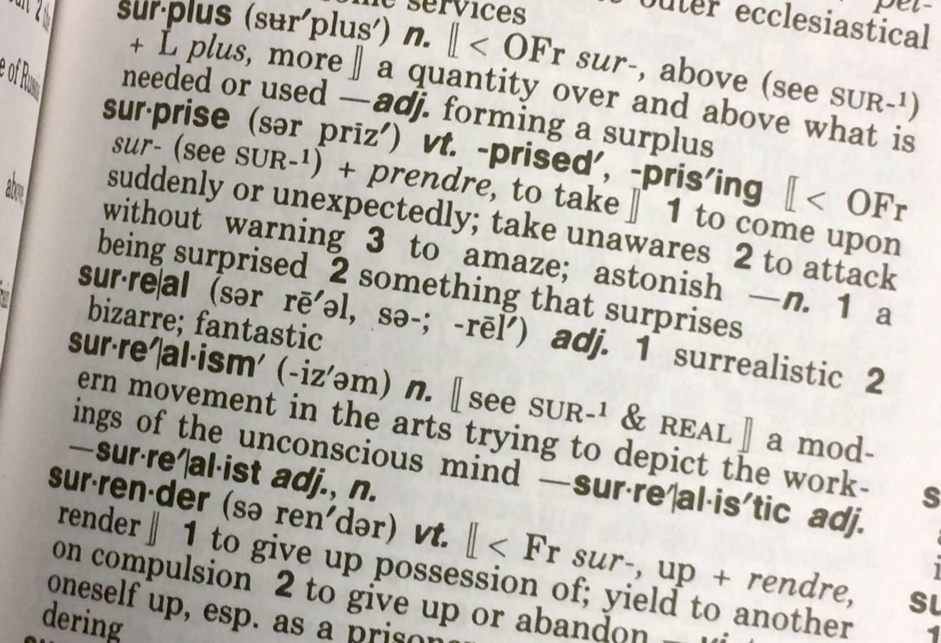
Storage metaphors
03 - Lexical Representations
Nick Riches
How are words stored?
Storage metaphors
Data from production errors Blends
Meaning-related rels.
Hyponymy Synonymy Antonymy Homonymy Polysemy
Homonyms versus Polysemes
Lexical gaps
What is a lexical gap?
Form-related rels.
Homophony Homography
Exploring sem. networks
Paradigms for exploring semantic networks
Speech errors
Types of speech errors
5-minute Exercise
2 / 35
Bibliography

Slide 4
Data from production errors
03 - Lexical Representations
Nick Riches
How are words stored?
Storage metaphors
Data from production errors Blends
Meaning-related rels.
Hyponymy Synonymy Antonymy Homonymy Polysemy
Homonyms versus Polysemes
They misunderestimated me
They can refudiate what this group is saying
I’m on my way to the lection
I don’t expose anyone will eat that
Lexical gaps
What is a lexical gap?
Form-related rels.
Homophony Homography
Exploring sem. networks
Paradigms for exploring semantic networks
Speech errors
Types of speech errors
5-minute Exercise
3 / 35
Bibliography

Slide 5
Blends
03 - Lexical Representations
Nick Riches
How are words stored?
Storage metaphors
Data from production errors Blends
Meaning-related rels.
Hyponymy Synonymy Antonymy Homonymy Polysemy
Homonyms versus Polysemes
1.
ute + repu
expect + su
Mis
understand +
under
estimate
→ misunderestimate
ref
diate
→ udiate
ref
pp
ose →
ex
p
ose
Lexical gaps
What is a lexical gap?
Form-related rels.
Homophony Homography
Exploring sem. networks
Paradigms for exploring semantic networks
Speech errors
Types of speech errors
5-minute Exercise
4 / 35
Bibliography

Slide 6
Blends
03 - Lexical Representations
Nick Riches
How are words stored?
Storage metaphors
Data from production errors Blends
Meaning-related rels.
Hyponymy Synonymy Antonymy Homonymy Polysemy
Homonyms versus Polysemes
Semantic and phonological processes
Combines opportunistic activation / assembly (biases speed over accuracy) with rigorous monitoring to prevent ‘leakage’ of nonwords
Lexical gaps
What is a lexical gap?
Form-related rels.
Homophony Homography
Exploring sem. networks
Paradigms for exploring semantic networks
Speech errors
Types of speech errors
5-minute Exercise
5 / 35
Bibliography

Slide 7
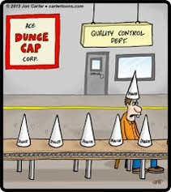
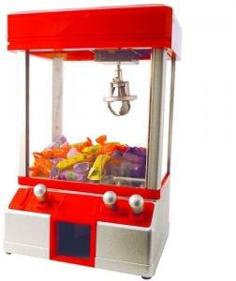
Blends
03 - Lexical Representations
Nick Riches
How are words stored?
Storage metaphors
Data from production errors Blends
Meaning-related rels.
Hyponymy Synonymy Antonymy Homonymy Polysemy
Homonyms versus Polysemes
Lexical gaps
What is a lexical gap?
Form-related rels.
Homophony Homography
Exploring sem. networks
Paradigms for exploring semantic networks
Speech errors
Types of speech errors
5-minute Exercise
6 / 35
Bibliography

Slide 8
03 - Lexical Representations
Nick Riches
How are words stored?
How are words stored?
Storage metaphors
Data from production errors Blends
Meaning-related relationships
Meaning-related rels.
Hyponymy Synonymy Antonymy Homonymy Polysemy
Homonyms versus Polysemes
Lexical gaps
Form-related relationships
Lexical gaps
What is a lexical gap?
Exploring semantic networks
Form-related rels.
Homophony Homography
Exploring word production using speech errors
Exploring sem. networks
Paradigms for exploring semantic networks
Speech errors
Types of speech errors
5-minute Exercise
5-minute Exercise
6 / 35
Bibliography

Slide 9
Hyponymy HYPO = under, NYM = name/word
03 - Lexical Representations
Nick Riches
How are words stored?
Storage metaphors
Data from production errors Blends
Hypo means under, and nym means name.
Meaning-related rels.
Hyponymy Synonymy Antonymy Homonymy Polysemy
Homonyms versus Polysemes
Lexical gaps
What is a lexical gap?
Form-related rels.
Homophony Homography
Exploring sem.
networks
Paradigms for exploring semantic networks
Speech errors
Types of speech errors
5-minute Exercise
7 / 35
Bibliography

Slide 10






Hyponymy HYPO = under, NYM = name/word
03 - Lexical Representations
Nick Riches
Hypo means under, and nym means name.
So a hyponym is a word which “comes under” another word;
How are words stored?
Storage metaphors
Data from production errors Blends
Meaning-related rels.
Hyponymy Synonymy Antonymy Homonymy Polysemy
Homonyms versus Polysemes
plant
flower
bush
Lexical gaps
What is a lexical gap?
Form-related rels.
Homophony Homography
Exploring sem.
lupin daisy rose tulip
networks
Paradigms for exploring semantic networks
Speech errors
Types of speech errors
5-minute Exercise
7 / 35
Bibliography

Slide 11







Hyponymy HYPO = under, NYM = name/word
03 - Lexical Representations
Nick Riches
plant
How are words stored?
Storage metaphors
Data from production errors Blends
Meaning-related rels.
Hyponymy Synonymy Antonymy Homonymy Polysemy
Homonyms versus Polysemes
flower
bush
lupin daisy rose tulip
Lexical gaps
What is a lexical gap?
Form-related rels.
Homophony Homography
Tulip is a hyponym / subordinate of flower, which is a hyponym / subordinate of plant
Exploring sem.
networks
Paradigms for exploring semantic networks
Speech errors
Types of speech errors
5-minute Exercise
8 / 35
Bibliography

Slide 12
Hyponymy HYPO = under, NYM = name/word
03 - Lexical Representations
Nick Riches
plant
How are words stored?
Storage metaphors
Data from production errors Blends
Meaning-related rels.
Hyponymy Synonymy Antonymy Homonymy Polysemy
Homonyms versus Polysemes
flower
bush
lupin daisy rose tulip
Lexical gaps
What is a lexical gap?
Form-related rels.
Homophony Homography
Tulip is a hyponym / subordinate of flower, which is a hyponym / subordinate of plant
Plant is a hyperonym / superordinate of flower, which is a
Exploring sem. networks
Paradigms for exploring
semantic networks
hyperonym / superordinate of tulip.
Speech errors
Types of speech errors
5-minute Exercise
8 / 35
Bibliography

Slide 13




Hyponymy HYPO = under, NYM = name/word
03 - Lexical Representations
Nick Riches
plant
How are words stored?
Storage metaphors
Data from production errors Blends
Meaning-related rels.
Hyponymy Synonymy Antonymy Homonymy Polysemy
Homonyms versus Polysemes
flower
bush
lupin daisy rose tulip
Lexical gaps
What is a lexical gap?
Form-related rels.
Homophony Homography
Tulip is a hyponym / subordinate of flower, which is a hyponym / subordinate of plant
Plant is a hyperonym / superordinate of flower, which is a hyperonym / superordinate of tulip.
Rose and tulip are co-hyponyms
Exploring sem. networks
Paradigms for exploring semantic networks
Speech errors
Types of speech errors
5-minute Exercise
8 / 35
Bibliography

Slide 14
Hyponymy HYPO = under, NYM = name/word
03 - Lexical Representations
Nick Riches
How are words stored?
Storage metaphors
Data from production errors Blends
Many words exist in co-hyponymic relationships, e.g.
(1) Round, square, oblong, oval, rectangular
Meaning-related rels.
Hyponymy Synonymy Antonymy Homonymy Polysemy
Homonyms versus Polysemes
(2) Road, street, drive, avenue
Lexical gaps
What is a lexical gap?
(3) Walk, run, hop, jump, crawl, gallop
Form-related rels.
Homophony Homography
Exploring sem. networks
Paradigms for exploring semantic networks
Speech errors
Types of speech errors
5-minute Exercise
9 / 35
Bibliography

Slide 15
Hyponymy HYPO = under, NYM = name/word
03 - Lexical Representations
Nick Riches
How are words stored?
Storage metaphors
Data from production errors Blends
Many words exist in co-hyponymic relationships, e.g.
Meaning-related rels.
Hyponymy Synonymy Antonymy Homonymy Polysemy
Homonyms versus Polysemes
(1) Round, square, oblong, oval, rectangular (= SHAPES)
(2) Road, street, drive, avenue
Lexical gaps
What is a lexical gap?
(3) Walk, run, hop, jump, crawl, gallop
Form-related rels.
Homophony Homography
Exploring sem. networks
Paradigms for exploring semantic networks
Speech errors
Types of speech errors
5-minute Exercise
9 / 35
Bibliography

Slide 16
Hyponymy HYPO = under, NYM = name/word
03 - Lexical Representations
Nick Riches
How are words stored?
Storage metaphors
Data from production errors Blends
Many words exist in co-hyponymic relationships, e.g.
Meaning-related rels.
Hyponymy Synonymy Antonymy Homonymy Polysemy
Homonyms versus Polysemes
(1) Round, square, oblong, oval, rectangular (= SHAPES)
(2) Road, street, drive, avenue (= THOROUGHFARES)
Lexical gaps
What is a lexical gap?
(3) Walk, run, hop, jump, crawl, gallop
Form-related rels.
Homophony Homography
Exploring sem. networks
Paradigms for exploring semantic networks
Speech errors
Types of speech errors
5-minute Exercise
9 / 35
Bibliography

Slide 17
Hyponymy HYPO = under, NYM = name/word
03 - Lexical Representations
Nick Riches
How are words stored?
Storage metaphors
Data from production errors Blends
Many words exist in co-hyponymic relationships, e.g.
Meaning-related rels.
Hyponymy Synonymy Antonymy Homonymy Polysemy
Homonyms versus Polysemes
(1) Round, square, oblong, oval, rectangular (= SHAPES)
(2) Road, street, drive, avenue (= THOROUGHFARES)
Lexical gaps
What is a lexical gap?
(3) Walk, run, hop, jump, crawl, gallop (= TYPES OF MOVEMENT MADE BY HUMANS AND ANIMALS)
Form-related rels.
Homophony Homography
Exploring sem. networks
Paradigms for exploring semantic networks
Speech errors
Types of speech errors
5-minute Exercise
9 / 35
Bibliography

Slide 18
Hyponymy HYPO = under, NYM = name/word
03 - Lexical Representations
Nick Riches
How are words stored?
Storage metaphors
Data from production errors Blends
Hyper- Hypo-nymic relationships can be conceptualised in terms of extension and intension
Meaning-related rels.
Hyponymy Synonymy Antonymy Homonymy Polysemy
Homonyms versus Polysemes
Lexical gaps
What is a lexical gap?
Form-related rels.
Homophony Homography
Exploring sem. networks
Paradigms for exploring semantic networks
Speech errors
Types of speech errors
5-minute Exercise
10 / 35
Bibliography

Slide 19
Hyponymy HYPO = under, NYM = name/word
03 - Lexical Representations
Nick Riches
How are words stored?
Storage metaphors
Data from production errors Blends
Hyper- Hypo-nymic relationships can be conceptualised in terms of extension and intension
The extension of chair is the set of real world objects described by chair, e.g.
Meaning-related rels.
Hyponymy Synonymy Antonymy Homonymy Polysemy
Homonyms versus Polysemes
Lexical gaps
What is a lexical gap?
Form-related rels.
Homophony Homography
Exploring sem. networks
Paradigms for exploring semantic networks
Speech errors
Types of speech errors
5-minute Exercise
10 / 35
Bibliography

Slide 20
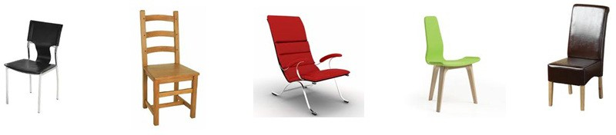
Hyponymy HYPO = under, NYM = name/word
03 - Lexical Representations
Nick Riches
How are words stored?
Storage metaphors
Data from production errors Blends
Hyper- Hypo-nymic relationships can be conceptualised in terms of extension and intension
The extension of chair is the set of real world objects described by chair, e.g.
Meaning-related rels.
Hyponymy Synonymy Antonymy Homonymy Polysemy
Homonyms versus Polysemes
Lexical gaps
What is a lexical gap?
Form-related rels.
Homophony Homography
Exploring sem. networks
Paradigms for exploring semantic networks
Speech errors
Types of speech errors
5-minute Exercise
10 / 35
Bibliography

Slide 21
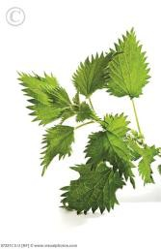
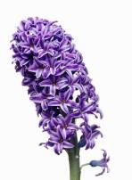



Hyponymy HYPO = under, NYM = name/word
03 - Lexical Representations
Nick Riches
Extension of plant words. . .
How are words stored?
Storage metaphors
Data from production errors Blends
plant
Meaning-related rels.
Hyponymy Synonymy Antonymy Homonymy Polysemy
Homonyms versus Polysemes
flower
daisy
Lexical gaps
What is a lexical gap?
Form-related rels.
Homophony Homography
Exploring sem. networks
Paradigms for exploring semantic networks
Speech errors
Types of speech errors
5-minute Exercise
11 / 35
Bibliography

Slide 22
Hyponymy HYPO = under, NYM = name/word
03 - Lexical Representations
The intension is the set of definitional properties which allow a word to pick out its referents
Nick Riches
How are words stored?
Storage metaphors
Data from production errors Blends
Meaning-related rels.
Hyponymy Synonymy Antonymy Homonymy Polysemy
Homonyms versus Polysemes
Lexical gaps
What is a lexical gap?
Form-related rels.
Homophony Homography
Exploring sem. networks
Paradigms for exploring semantic networks
Speech errors
Types of speech errors
5-minute Exercise
12 / 35
Bibliography

Slide 23
Hyponymy HYPO = under, NYM = name/word
03 - Lexical Representations
The intension is the set of definitional properties which allow a word to pick out its referents
What is the intension of chair ?
Nick Riches
How are words stored?
Storage metaphors
Data from production errors Blends
Meaning-related rels.
Hyponymy Synonymy Antonymy Homonymy Polysemy
Homonyms versus Polysemes
Lexical gaps
What is a lexical gap?
Form-related rels.
Homophony Homography
Exploring sem. networks
Paradigms for exploring
semantic networks
Speech errors
Types of speech errors
5-minute Exercise
12 / 35
Bibliography

Slide 24
Hyponymy HYPO = under, NYM = name/word
03 - Lexical Representations
The intension is the set of definitional properties which allow a word to pick out its referents
What is the intension of chair ?
Nick Riches
How are words stored?
Storage metaphors
Data from production errors Blends
Meaning-related rels.
Hyponymy Synonymy Antonymy Homonymy Polysemy
Homonyms versus Polysemes
daisy
flower
plant
Living
organism
Extracts water
Photo-
synthesises
Reproductive role
White petals
Yellow centre
Lexical gaps
What is a lexical gap?
Living
organism
Extracts water
Photo-
synthesises
Living
organism
Extracts water
Photo-
synthesises
Reproductive role
Petals
Form-related rels.
Homophony Homography
Exploring sem. networks
Paradigms for exploring
semantic networks
Speech errors
Types of speech errors
5-minute Exercise
12 / 35
Bibliography

Slide 25
Synonmy SYN = same, NYM = word/name
03 - Lexical Representations
Nick Riches
How are words stored?
Storage metaphors
Data from production errors Blends
Words with identical meanings.
chap / bloke / geezer ?
fiesta / knees up / bash / soir´ee?
Meaning-related rels.
Hyponymy Synonymy Antonymy Homonymy Polysemy
Homonyms versus Polysemes
Lexical gaps
What is a lexical gap?
Form-related rels.
Homophony Homography
Exploring sem. networks
Paradigms for exploring semantic networks
Speech errors
Types of speech errors
5-minute Exercise
13 / 35
Bibliography

Slide 26
Synonmy SYN = same, NYM = word/name
03 - Lexical Representations
Nick Riches
How are words stored?
Storage metaphors
Data from production errors Blends
Words with identical meanings.
chap / bloke / geezer ?
fiesta / knees up / bash / soir´ee? Denotation versus connotation
Meaning-related rels.
Hyponymy Synonymy Antonymy Homonymy Polysemy
Homonyms versus Polysemes
Lexical gaps
What is a lexical gap?
Form-related rels.
Homophony Homography
Exploring sem. networks
Paradigms for exploring semantic networks
Speech errors
Types of speech errors
5-minute Exercise
13 / 35
Bibliography

Slide 27
Synonmy SYN = same, NYM = word/name
03 - Lexical Representations
Nick Riches
How are words stored?
Storage metaphors
Data from production errors Blends
Words with identical meanings.
chap / bloke / geezer ?
fiesta / knees up / bash / soir´ee?
Denotation versus connotation
tap / fawcett, pavement / sidewalk?
however, nonetheless, nevertheless?
Meaning-related rels.
Hyponymy Synonymy Antonymy Homonymy Polysemy
Homonyms versus Polysemes
Lexical gaps
What is a lexical gap?
Form-related rels.
Homophony Homography
Exploring sem.
networks
Paradigms for exploring semantic networks
Speech errors
Types of speech errors
5-minute Exercise
13 / 35
Bibliography

Slide 28
Synonmy SYN = same, NYM = word/name
03 - Lexical Representations
Nick Riches
How are words stored?
Storage metaphors
Data from production errors Blends
Words with identical meanings.
chap / bloke / geezer ?
fiesta / knees up / bash / soir´ee?
Denotation versus connotation
tap / fawcett, pavement / sidewalk?
however, nonetheless, nevertheless?
‘natural languages abhor absolute synonyms just as nature abhors a vacuum’ (Cruse 1986)
Meaning-related rels.
Hyponymy Synonymy Antonymy Homonymy Polysemy
Homonyms versus Polysemes
Lexical gaps
What is a lexical gap?
Form-related rels.
Homophony Homography
Exploring sem.
networks
Paradigms for exploring semantic networks
Speech errors
Types of speech errors
5-minute Exercise
13 / 35
Bibliography

Slide 29
Antonmy ANT = opposite, NYM = name/word
03 - Lexical Representations
Nick Riches
How are words stored?
Storage metaphors
Data from production errors Blends
Opposite meanings.
Gradable (e.g. slightly hot, very cold ) versus non-gradable (e.g. *very dead )
Meaning-related rels.
Hyponymy Synonymy Antonymy Homonymy Polysemy
Homonyms versus Polysemes
Lexical gaps
What is a lexical gap?
Form-related rels.
Homophony Homography
Exploring sem.
networks
Paradigms for exploring semantic networks
Speech errors
Types of speech errors
5-minute Exercise
14 / 35
Bibliography

Slide 30
Antonmy ANT = opposite, NYM = name/word
03 - Lexical Representations
Nick Riches
How are words stored?
Storage metaphors
Data from production errors Blends
Opposite meanings.
Gradable (e.g. slightly hot, very cold ) versus non-gradable (e.g. *very dead )
Opposite of virgin?
Meaning-related rels.
Hyponymy Synonymy Antonymy Homonymy Polysemy
Homonyms versus Polysemes
Lexical gaps
What is a lexical gap?
Form-related rels.
Homophony Homography
Exploring sem. networks
Paradigms for exploring semantic networks
Speech errors
Types of speech errors
5-minute Exercise
14 / 35
Bibliography

Slide 31
Antonmy ANT = opposite, NYM = name/word
03 - Lexical Representations
Nick Riches
How are words stored?
Storage metaphors
Data from production errors Blends
Opposite meanings.
Gradable (e.g. slightly hot, very cold ) versus non-gradable (e.g. *very dead )
Opposite of virgin? Lexical gap
Meaning-related rels.
Hyponymy Synonymy Antonymy Homonymy Polysemy
Homonyms versus Polysemes
Lexical gaps
What is a lexical gap?
Form-related rels.
Homophony Homography
Exploring sem. networks
Paradigms for exploring semantic networks
Speech errors
Types of speech errors
5-minute Exercise
14 / 35
Bibliography

Slide 32
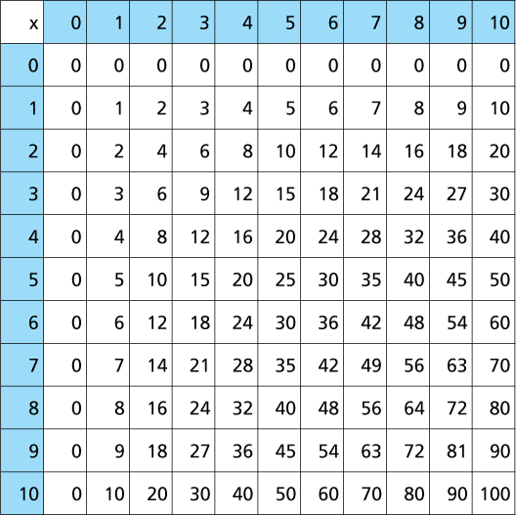
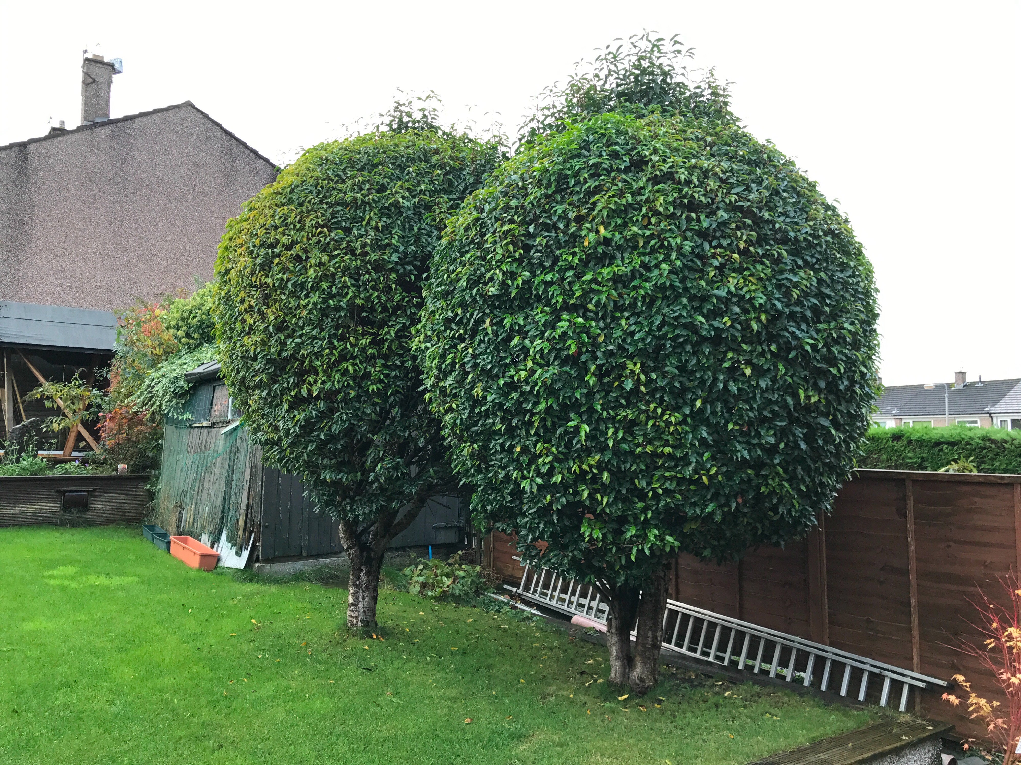
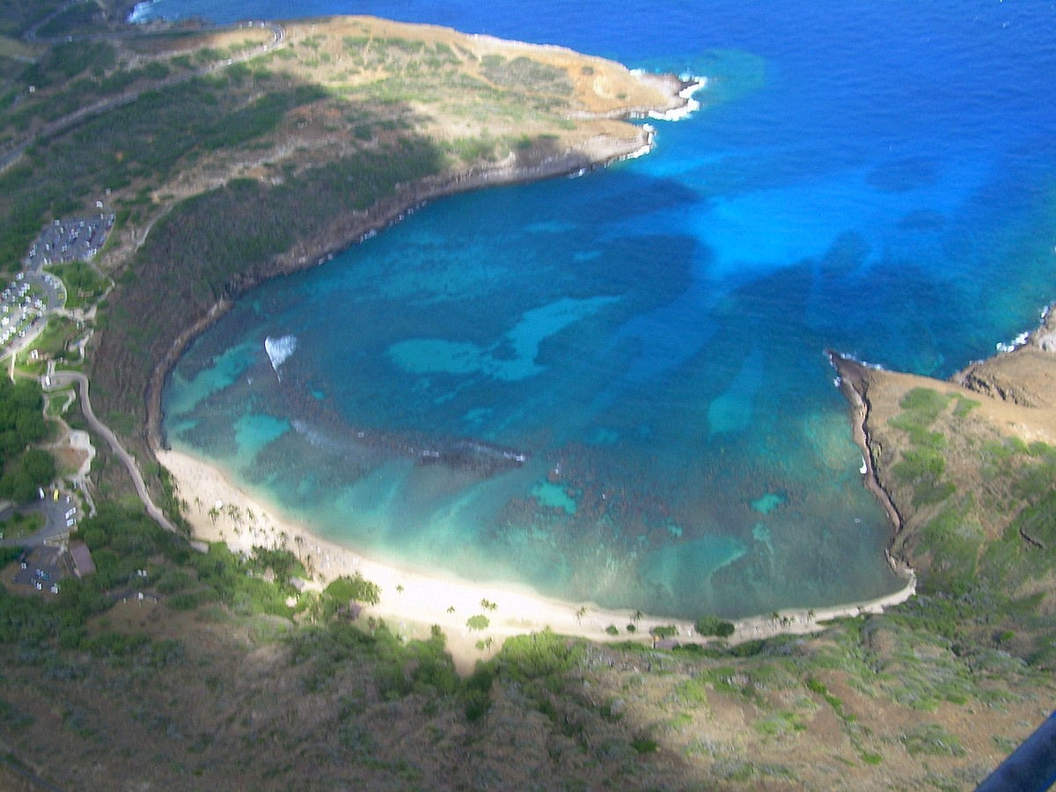
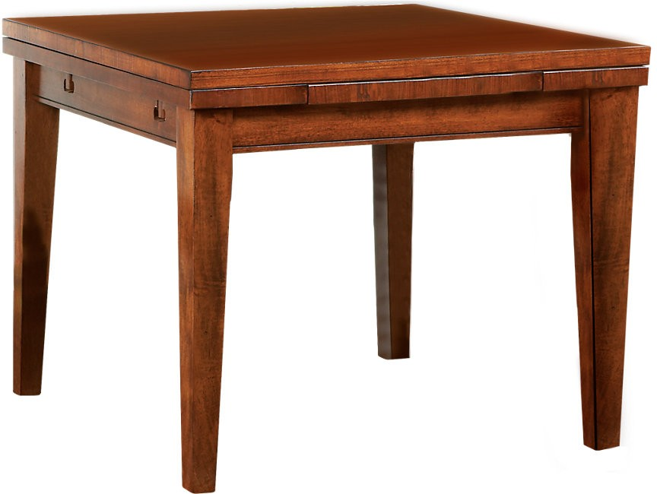
Homonymy HOMO = same, NYM = name/word
03 - Lexical Representations
Same form, different meanings. Often the result of historical accident
Nick Riches
How are words stored?
Storage metaphors
Data from production errors Blends
Meaning-related rels.
Hyponymy Synonymy Antonymy Homonymy Polysemy
Homonyms versus Polysemes
ENG: bay
ENG: bay
ENG: table
ENG: table
Lexical gaps
What is a lexical gap?
Form-related rels.
Homophony Homography
Exploring sem. networks
Paradigms for exploring semantic networks
OLD FRENCH:
baie
LATIN: baca
Speech errors
LATIN: tabula
Types of speech errors
5-minute Exercise
15 / 35
Bibliography

Slide 33
Polysemy POLY = multiple, SEM = meaning
03 - Lexical Representations
Nick Riches
How are words stored?
Storage metaphors
Data from production errors Blends
Same form, and different but related meanings. The meaning relationship is mentally represented
Meaning-related rels.
Hyponymy Synonymy Antonymy Homonymy Polysemy
Homonyms versus Polysemes
NOUN _{PHENOMENON} = polysemy /p@"lIs@mi:/
NOUN = polysemes
REFERRING TO POLYSEMOUS WORDS
/"p6li:si:mz/
ADJ. = polysemous /p@"lIs@m@s/
Lexical gaps
What is a lexical gap?
Form-related rels.
Homophony Homography
Exploring sem.
networks
Paradigms for exploring semantic networks
Speech errors
Types of speech errors
5-minute Exercise
16 / 35
Bibliography

Slide 34
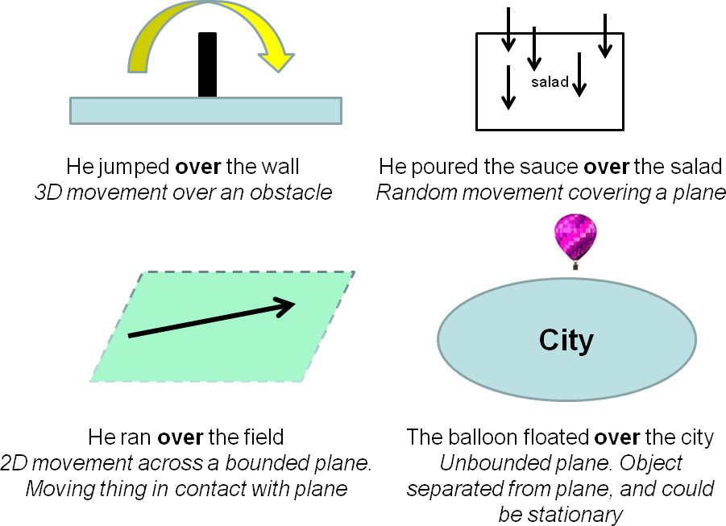
Polysemy POLY = multiple, SEM = meaning
03 - Lexical Representations
Nick Riches
How are words stored?
Storage metaphors
Data from production errors Blends
Meaning-related rels.
Hyponymy Synonymy Antonymy Homonymy Polysemy
Homonyms versus Polysemes
Lexical gaps
What is a lexical gap?
Form-related rels.
Homophony Homography
Exploring sem.
networks
Paradigms for exploring semantic networks
Speech errors
Types of speech errors
5-minute Exercise
17 / 35
Bibliography

Slide 35
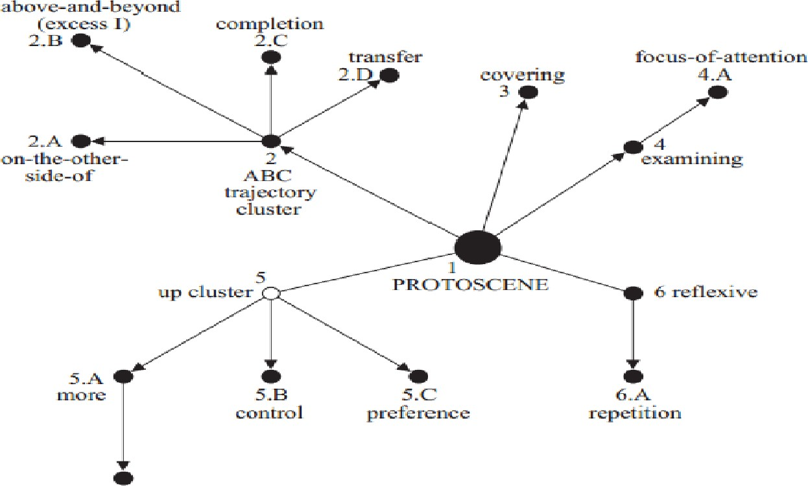
Polysemy POLY = multiple, SEM = meaning
03 - Lexical Representations
Nick Riches
How are words stored?
Storage metaphors
Data from production errors Blends
Meaning-related rels.
Hyponymy Synonymy Antonymy Homonymy Polysemy
Homonyms versus Polysemes
Lexical gaps
What is a lexical gap?
Form-related rels.
Homophony Homography
Exploring sem. networks
Paradigms for exploring semantic networks
Speech errors
Types of speech errors
5-minute Exercise
18 / 35
Bibliography

Slide 36
Polysemy POLY = multiple, SEM = meaning
03 - Lexical Representations
Nick Riches
How are words stored?
Storage metaphors
Data from production errors Blends
Other polysemous words; bed, full
Meaning-related rels.
Hyponymy Synonymy Antonymy Homonymy Polysemy
Homonyms versus Polysemes
Lexical gaps
What is a lexical gap?
Form-related rels.
Homophony Homography
Exploring sem. networks
Paradigms for exploring semantic networks
Speech errors
Types of speech errors
5-minute Exercise
19 / 35
Bibliography

Slide 37
Polysemy POLY = multiple, SEM = meaning
03 - Lexical Representations
Nick Riches
How are words stored?
Storage metaphors
Data from production errors Blends
Other polysemous words; bed, full
Meaning-related rels.
Hyponymy Synonymy Antonymy Homonymy Polysemy
Homonyms versus Polysemes
He went to bed, a river-bed, flower bed, the steak was served on a bed of lettuce
The cup was full, the room was full, she has a full schedule, she leads a full life.
Lexical gaps
What is a lexical gap?
Form-related rels.
Homophony Homography
Exploring sem.
networks
Paradigms for exploring semantic networks
Speech errors
Types of speech errors
5-minute Exercise
19 / 35
Bibliography

Slide 38
Polysemy POLY = multiple, SEM = meaning
03 - Lexical Representations
Nick Riches
How are words stored?
Storage metaphors
Data from production errors Blends
Meaning-related rels.
Hyponymy Synonymy Antonymy Homonymy Polysemy
Homonyms versus Polysemes
Are meaning relationships mentally represented?
Lexical gaps
What is a lexical gap?
Form-related rels.
Homophony Homography
Exploring sem.
networks
Paradigms for exploring semantic networks
Speech errors
Types of speech errors
5-minute Exercise
20 / 35
Bibliography

Slide 39
Polysemy POLY = multiple, SEM = meaning
03 - Lexical Representations
Nick Riches
How are words stored?
Storage metaphors
Data from production errors Blends
Are these words homonyms or polysemes?
gear (NOUN)
church (NOUN)
lead (NOUN)
good (ADJ)
Meaning-related rels.
Hyponymy Synonymy Antonymy Homonymy Polysemy
Homonyms versus Polysemes
Lexical gaps
What is a lexical gap?
Form-related rels.
Homophony Homography
Exploring sem. networks
Paradigms for exploring semantic networks
Speech errors
Types of speech errors
5-minute Exercise
21 / 35
Bibliography

Slide 40
Polysemy POLY = multiple, SEM = meaning
03 - Lexical Representations
Nick Riches
How are words stored?
Storage metaphors
Data from production errors Blends
She’s a good person
He’s a good student
It’s a good car
This floor needs a good scrubbing
I need a good drink
Meaning-related rels.
Hyponymy Synonymy Antonymy Homonymy Polysemy
Homonyms versus Polysemes
Lexical gaps
What is a lexical gap?
Form-related rels.
Homophony Homography
Exploring sem. networks
Paradigms for exploring semantic networks
Speech errors
Types of speech errors
5-minute Exercise
22 / 35
Bibliography

Slide 41
03 - Lexical Representations
Nick Riches
How are words stored?
How are words stored?
Storage metaphors
Data from production errors Blends
Meaning-related relationships
Meaning-related rels.
Hyponymy Synonymy Antonymy Homonymy Polysemy
Homonyms versus Polysemes
Lexical gaps
Form-related relationships
Lexical gaps
What is a lexical gap?
Exploring semantic networks
Form-related rels.
Homophony Homography
Exploring word production using speech errors
Exploring sem. networks
Paradigms for exploring semantic networks
Speech errors
Types of speech errors
5-minute Exercise
5-minute Exercise
22 / 35
Bibliography

Slide 42
What is a lexical gap?
03 - Lexical Representations
Nick Riches
How are words stored?
Storage metaphors
Data from production errors Blends
Meaning-related rels.
Hyponymy Synonymy Antonymy Homonymy Polysemy
Homonyms versus Polysemes
We want to express a concept, but there is no existing word.
Opposite of bald?
Opposite of virgin?
Lexical gaps
What is a lexical gap?
Form-related rels.
Homophony Homography
Exploring sem. networks
Paradigms for exploring semantic networks
Speech errors
Types of speech errors
5-minute Exercise
23 / 35
Bibliography

Slide 43
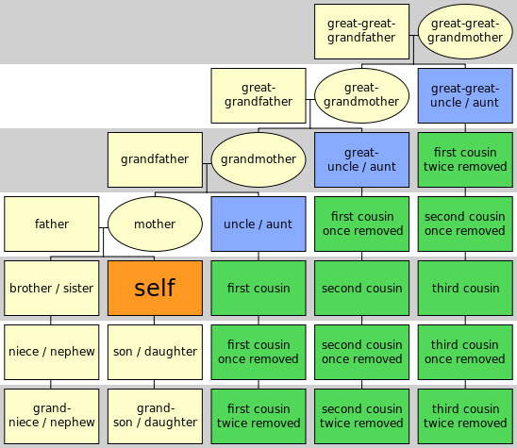
What is a lexical gap?
03 - Lexical Representations
Nick Riches
How are words stored?
Storage metaphors
Data from production errors Blends
Meaning-related rels.
Hyponymy Synonymy Antonymy Homonymy Polysemy
Homonyms versus Polysemes
Lexical gaps
What is a lexical gap?
Form-related rels.
Homophony Homography
Exploring sem. networks
Paradigms for exploring semantic networks
Speech errors
Types of speech errors
5-minute Exercise
24 / 35
Bibliography

Slide 44
What is a lexical gap?
03 - Lexical Representations
Nick Riches
How are words stored?
Storage metaphors
Data from production errors Blends
Meaning-related rels.
Hyponymy Synonymy Antonymy Homonymy Polysemy
Homonyms versus Polysemes
Loanwords
Lexical gaps
What is a lexical gap?
Form-related rels.
Homophony Homography
Exploring sem. networks
Paradigms for exploring semantic networks
Speech errors
Types of speech errors
5-minute Exercise
25 / 35
Bibliography

Slide 45
What is a lexical gap?
03 - Lexical Representations
Nick Riches
How are words stored?
Storage metaphors
Data from production errors Blends
Meaning-related rels.
Hyponymy Synonymy Antonymy Homonymy Polysemy
Homonyms versus Polysemes
Loanwords
kitsch, schadenfreude, and hygge.
Lexical gaps
What is a lexical gap?
Form-related rels.
Homophony Homography
Exploring sem. networks
Paradigms for exploring semantic networks
Speech errors
Types of speech errors
5-minute Exercise
25 / 35
Bibliography

Slide 46
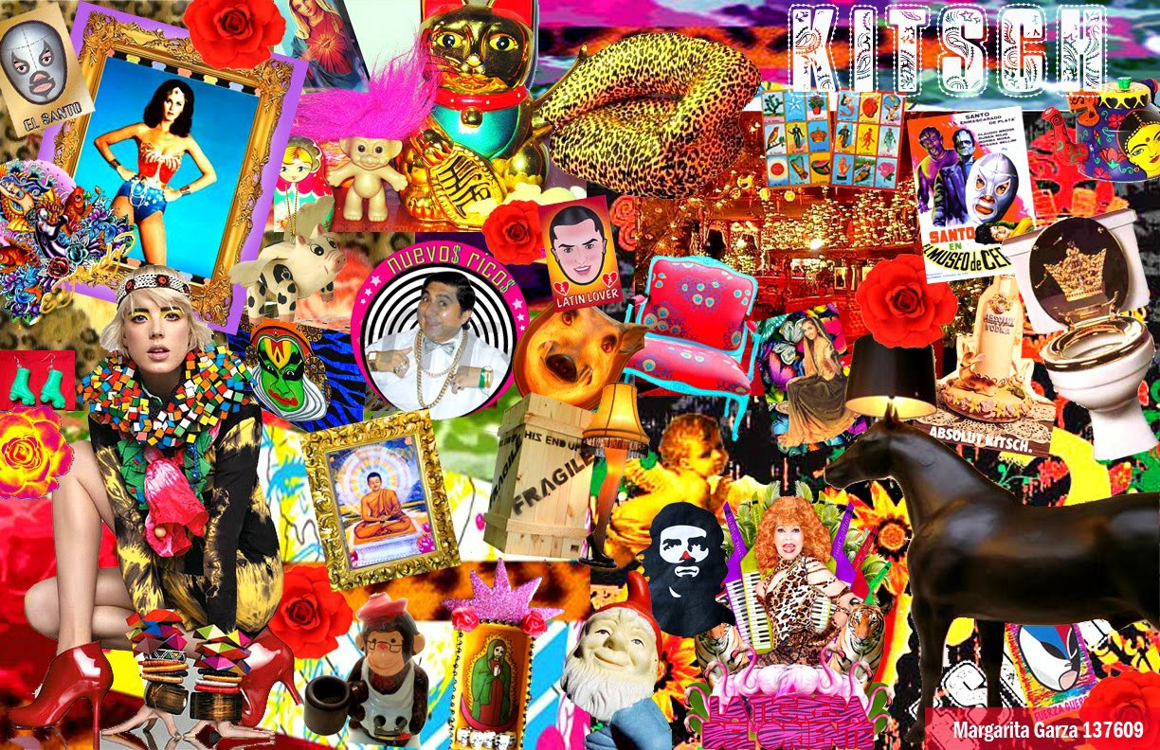
What is a lexical gap?
03 - Lexical Representations
Nick Riches
How are words stored?
Storage metaphors
Data from production errors Blends
Meaning-related rels.
Hyponymy Synonymy Antonymy Homonymy Polysemy
Homonyms versus Polysemes
Lexical gaps
What is a lexical gap?
Form-related rels.
Homophony Homography
Exploring sem. networks
Paradigms for exploring semantic networks
Speech errors
Types of speech errors
5-minute Exercise
26 / 35
Bibliography

Slide 47
03 - Lexical Representations
Nick Riches
How are words stored?
How are words stored?
Storage metaphors
Data from production errors Blends
Meaning-related relationships
Meaning-related rels.
Hyponymy Synonymy Antonymy Homonymy Polysemy
Homonyms versus Polysemes
Lexical gaps
Form-related relationships
Lexical gaps
What is a lexical gap?
Exploring semantic networks
Form-related rels.
Homophony Homography
Exploring word production using speech errors
Exploring sem. networks
Paradigms for exploring semantic networks
Speech errors
Types of speech errors
5-minute Exercise
5-minute Exercise
26 / 35
Bibliography

Slide 48
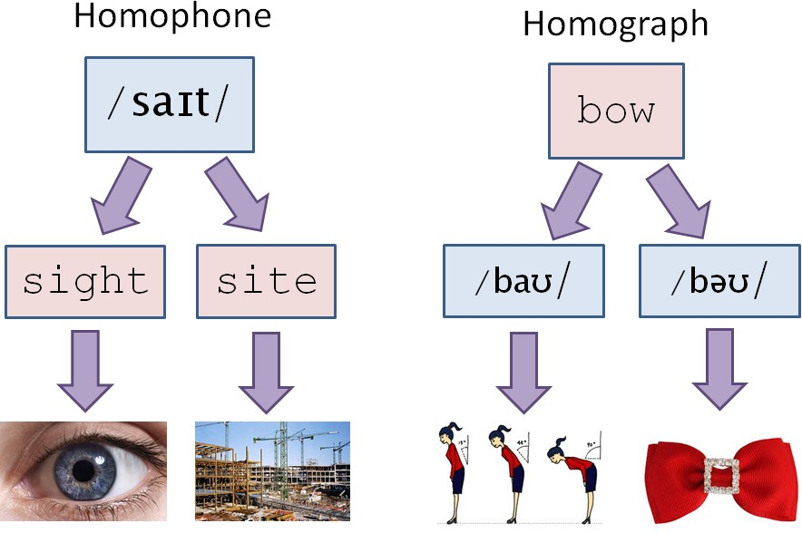
Homophony HOMO = same / PHONO = sound
03 - Lexical Representations
Nick Riches
How are words stored?
Storage metaphors
Data from production errors Blends
Meaning-related rels.
Hyponymy Synonymy Antonymy Homonymy Polysemy
Homonyms versus Polysemes
Lexical gaps
What is a lexical gap?
Form-related rels.
Homophony Homography
Exploring sem. networks
Paradigms for exploring semantic networks
Speech errors
Types of speech errors
5-minute Exercise
27 / 35
Bibliography

Slide 49
Homophony HOMO = same / PHONO = sound
03 - Lexical Representations
Nick Riches
How are words stored?
Storage metaphors
Data from production errors Blends
Meaning-related rels.
Hyponymy Synonymy Antonymy Homonymy Polysemy
Homonyms versus Polysemes
Same spoken form, different written forms (with different meanings)
e.g. might / mite, leak / leek
Lexical gaps
What is a lexical gap?
Form-related rels.
Homophony Homography
Exploring sem. networks
Paradigms for exploring semantic networks
Speech errors
Types of speech errors
5-minute Exercise
28 / 35
Bibliography

Slide 50
Homography HOMO = same / GRAPH = writing
03 - Lexical Representations
Nick Riches
How are words stored?
Storage metaphors
Data from production errors Blends
Meaning-related rels.
Hyponymy Synonymy Antonymy Homonymy Polysemy
Homonyms versus Polysemes
Lexical gaps
What is a lexical gap?
Form-related rels.
Homophony Homography
Exploring sem. networks
Paradigms for exploring semantic networks
Speech errors
Types of speech errors
5-minute Exercise
29 / 35
Bibliography

Slide 51
Homography HOMO = same / GRAPH = writing
03 - Lexical Representations
Nick Riches
How are words stored?
Storage metaphors
Data from production errors Blends
Same written form, different spoken forms (with different meanings)
e.g. bow, minute
Meaning-related rels.
Hyponymy Synonymy Antonymy Homonymy Polysemy
Homonyms versus Polysemes
Lexical gaps
What is a lexical gap?
Form-related rels.
Homophony Homography
Exploring sem. networks
Paradigms for exploring semantic networks
Speech errors
Types of speech errors
5-minute Exercise
30 / 35
Bibliography

Slide 52
Homography HOMO = same / GRAPH = writing
03 - Lexical Representations
Nick Riches
How are words stored?
Storage metaphors
Data from production errors Blends
Same written form, different spoken forms (with different meanings)
e.g. bow, minute
/baU/ = what you do when you meet the queen, versus bow
/b@U/ = a bow tie
/"mInIt/ = a unit of time, versus /maI"nju:t/ = very small
Meaning-related rels.
Hyponymy Synonymy Antonymy Homonymy Polysemy
Homonyms versus Polysemes
Lexical gaps
What is a lexical gap?
Form-related rels.
Homophony Homography
Exploring sem. networks
Paradigms for exploring semantic networks
Speech errors
Types of speech errors
5-minute Exercise
30 / 35
Bibliography

Slide 53
03 - Lexical Representations
Nick Riches
How are words stored?
How are words stored?
Storage metaphors
Data from production errors Blends
Meaning-related relationships
Meaning-related rels.
Hyponymy Synonymy Antonymy Homonymy Polysemy
Homonyms versus Polysemes
Lexical gaps
Form-related relationships
Lexical gaps
What is a lexical gap?
Exploring semantic networks
Form-related rels.
Homophony Homography
Exploring word production using speech errors
Exploring sem. networks
Paradigms for exploring semantic networks
Speech errors
Types of speech errors
5-minute Exercise
5-minute Exercise
30 / 35
Bibliography

Slide 54
Paradigms
03 - Lexical Representations
Nick Riches
How are words stored?
Storage metaphors
Data from production errors Blends
Word association norms, e.g. Edinburgh Associative Thesaurus
A says a word, and B says the first word that comes into their heads
Semantic fluency tasks
A asks B to say as many words as possible from a single category, e.g. animals, things you take on holidays
Semantic priming
Does hearing word A speed up the processing of word B?
Meaning-related rels.
Hyponymy Synonymy Antonymy Homonymy Polysemy
Homonyms versus Polysemes
Lexical gaps
What is a lexical gap?
Form-related rels.
Homophony Homography
Exploring sem. networks
Paradigms for exploring semantic networks
Speech errors
Types of speech errors
5-minute Exercise
31 / 35
Bibliography

Slide 55
03 - Lexical Representations
Nick Riches
How are words stored?
How are words stored?
Storage metaphors
Data from production errors Blends
Meaning-related relationships
Meaning-related rels.
Hyponymy Synonymy Antonymy Homonymy Polysemy
Homonyms versus Polysemes
Lexical gaps
Form-related relationships
Lexical gaps
What is a lexical gap?
Exploring semantic networks
Form-related rels.
Homophony Homography
Exploring word production using speech errors
Exploring sem. networks
Paradigms for exploring semantic networks
Speech errors
Types of speech errors
5-minute Exercise
5-minute Exercise
31 / 35
Bibliography

Slide 56
Types of speech errors
03 - Lexical Representations
Nick Riches
How are words stored?
Storage metaphors
Data from production errors Blends
Types of error:
Blend, e.g. lection
Phonological substitution (malapropism), e.g. The Chinese emperor had many concubines ⇒ porcupines,
Meaning-related rels.
Hyponymy Synonymy Antonymy Homonymy Polysemy
Homonyms versus Polysemes
Brexit means Brexit ⇒ breakfast (Link to YouTube
video)
Lexical substitution, e.g. Give me the hammer
⇒ screwdriver.
Tip of the tongue effects = we know the meaning of the word we want, but phonological access is partial
Lexical gaps
What is a lexical gap?
Form-related rels.
Homophony Homography
Exploring sem. networks
Paradigms for exploring semantic networks
Speech errors
Types of speech errors
5-minute Exercise
32 / 35
Bibliography

Slide 57
Types of speech errors
03 - Lexical Representations
Nick Riches
How errors provide evidence for two-stage model
How are words stored?
Storage metaphors
Data from production errors Blends
 | 1 | 2 | 3
Concept | √ | √ | √
1. Lemma (semantics) | Mis- selection | √ | √
2. Lexeme (word form) | √ | Mis- selection | Partial
Articulation | √ | √ | X
Meaning-related rels.
Hyponymy Synonymy Antonymy Homonymy Polysemy
Homonyms versus Polysemes
Lexical gaps
What is a lexical gap?
Form-related rels.
Homophony Homography
Semantic Substitution Crossword
→ Jigsaw
Phonological substitution / malapropism concubine → porcupine
TOT
effects
Exploring sem. networks
Paradigms for exploring semantic networks
Speech errors
Types of speech errors
5-minute Exercise
33 / 35
Bibliography

Slide 58
03 - Lexical Representations
Nick Riches
How are words stored?
How are words stored?
Storage metaphors
Data from production errors Blends
Meaning-related relationships
Meaning-related rels.
Hyponymy Synonymy Antonymy Homonymy Polysemy
Homonyms versus Polysemes
Lexical gaps
Form-related relationships
Lexical gaps
What is a lexical gap?
Exploring semantic networks
Form-related rels.
Homophony Homography
Exploring word production using speech errors
Exploring sem. networks
Paradigms for exploring semantic networks
Speech errors
Types of speech errors
5-minute Exercise
5-minute Exercise
33 / 35
Bibliography

Slide 59
03 - Lexical Representations
Nick Riches
How are words stored?
Storage metaphors
Data from production errors Blends
How many ‘units of meaning’ in the following words:
Meaning-related rels.
Hyponymy Synonymy Antonymy Homonymy Polysemy
Homonyms versus Polysemes
Dogs
Laughed
Working
Believe
Unbelievable
Sang
Lexical gaps
What is a lexical gap?
Form-related rels.
Homophony Homography
Exploring sem. networks
Paradigms for exploring semantic networks
Speech errors
Types of speech errors
5-minute Exercise
34 / 35
Bibliography

Slide 60
03 - Lexical Representations
Nick Riches
How are words stored?
How are words stored?
Storage metaphors
Data from production errors Blends
Meaning-related relationships
Meaning-related rels.
Hyponymy Synonymy Antonymy Homonymy Polysemy
Homonyms versus Polysemes
Lexical gaps
Form-related relationships
Lexical gaps
What is a lexical gap?
Exploring semantic networks
Form-related rels.
Homophony Homography
Exploring word production using speech errors
Exploring sem. networks
Paradigms for exploring semantic networks
Speech errors
Types of speech errors
5-minute Exercise
5-minute Exercise
34 / 35
Bibliography

Slide 61
03 - Lexical Representations
Nick Riches
How are words stored?
Storage metaphors
Data from production errors Blends
Kail, R., & Leonard, L. (1986). Word-finding abilities in language-impaired children.
Bishop, D. V. M., & Norbury, C. F. (2005). Executive functions in children with communication impairments, in relation to autistic symptomatology: I Generativity. Autism, 9 (1), 7–27.
Gomez, R. G., & White, D. A. (2006). Using verbal fluency to detect very mild dementia of the Alzheimer type.
Archives of Clinical Neuropsychology, 21 (8), 771–775.
Meaning-related rels.
Hyponymy Synonymy Antonymy Homonymy Polysemy
Homonyms versus Polysemes
Lexical gaps
What is a lexical gap?
Form-related rels.
Homophony Homography
Exploring sem. networks
Paradigms for exploring semantic networks
Speech errors
Types of speech errors
5-minute Exercise
35 / 35
Bibliography

